Slide 1
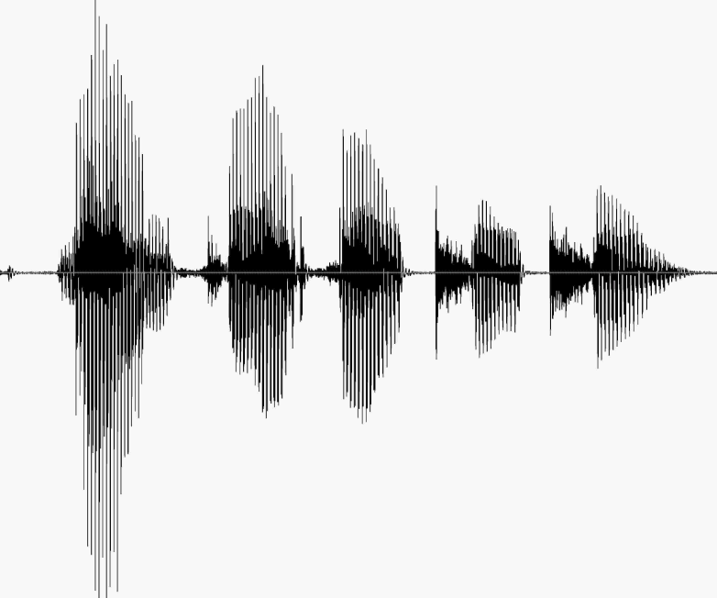
CS 224S / LINGUIST 285 Spoken Language Processing
Andrew Maas
Stanford University
Spring 2017
Lecture 14: Text-to-Speech I: Text Normalization, Letter to Sound, Prosody
Original slides by Dan Jurafsky, Alan Black, & Richard Sproat

Slide 2
Outline
History, Demos
Architectural Overview
Stage 1: Text Analysis
Text Normalization
Tokenization
End of sentence detection
Homograph disambiguation
Letter-to-sound (grapheme-to-phoneme)
Prosody

Slide 3
Dave Barry on TTS
“And computers are getting smarter all the time; scientists tell us that soon they will be able to talk with us.
(By “they”, I mean computers; I doubt scientists will ever be able to talk to us.)

Slide 4
History of TTS
Pictures and some text from Hartmut Traunmüller’s web site:
http://www.ling.su.se/staff/hartmut/kemplne.htm
Von Kempeln 1780 b. Bratislava 1734 d. Vienna 1804
Leather resonator manipulated by the operator to try and copy vocal tract configuration during sonorants (vowels, glides, nasals)
Bellows provided air stream, counterweight provided inhalation
Vibrating reed produced periodic pressure wave

Slide 5
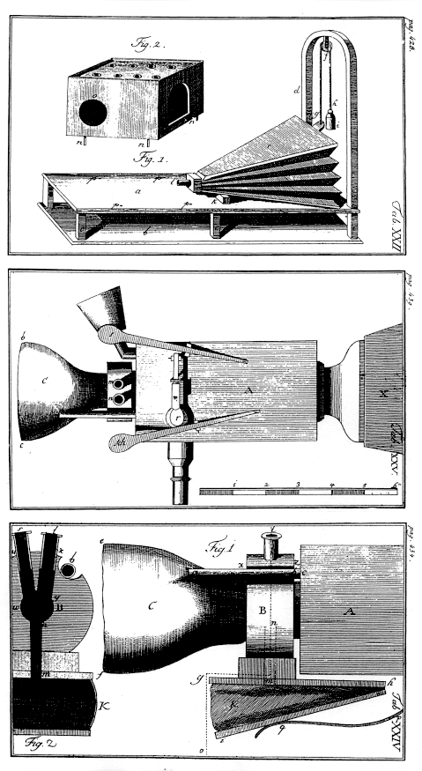
Von Kempelen:
Small whistles controlled consonants
Rubber mouth and nose; nose had to be covered with two fingers for non-nasals
Unvoiced sounds: mouth covered, auxiliary bellows driven by string provides puff of air
From Traunmüller’s web site

Slide 6
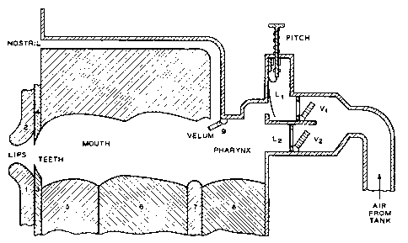
Closer to a natural vocal tract: Riesz 1937

Slide 7
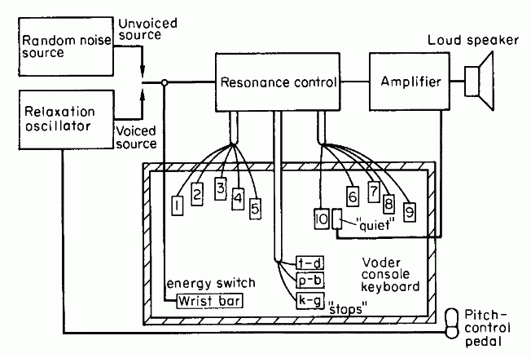
Homer Dudley 1939 VODER
Synthesizing speech by electrical means
1939 World’s Fair

Slide 8
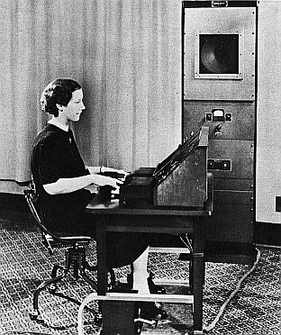

Homer Dudley’s VODER
Manually controlled through complex keyboard
Operator training was a problem

Slide 9
An aside on demos
That last slide exhibited:
Rule 1 of playing a speech synthesis demo:
Always have a human say what the words are right before you have the system say them

Slide 10
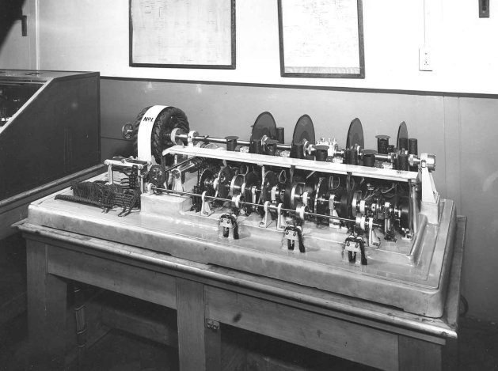
The 1936 UK Speaking Clock
From http://web.ukonline.co.uk/freshwater/clocks/spkgclock.htm

Slide 11
The UK Speaking Clock
July 24, 1936
Photographic storage on 4 glass disks
2 disks for minutes, 1 for hour, one for seconds.
Other words in sentence distributed across 4 disks, so all 4 used at once.
Voice of “Miss J. Cain”

Slide 12
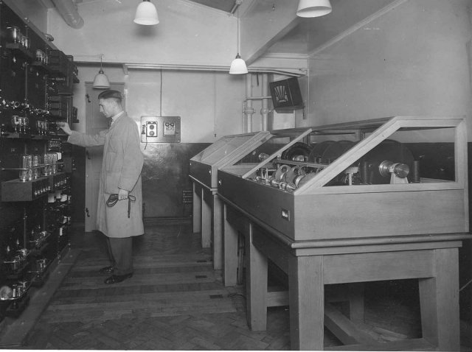
A technician adjusts the amplifiers of the first speaking clock
From http://web.ukonline.co.uk/freshwater/clocks/spkgclock.htm

Slide 13
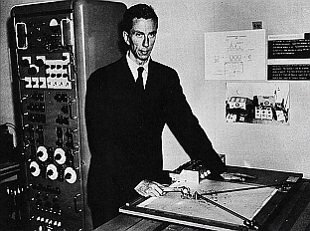
Gunnar Fant’s OVE synthesizer
Of the Royal Institute of Technology, Stockholm
Formant Synthesizer for vowels
F1 and F2 could be controlled
From Traunmüller’s web site

Slide 14
Cooper’s Pattern Playback
Haskins Labs for investigating speech perception
Works like an inverse of a spectrograph
Light from a lamp goes through a rotating disk then through spectrogram into photovoltaic cells
Thus amount of light that gets transmitted at each frequency band corresponds to amount of acoustic energy at that band

Slide 15
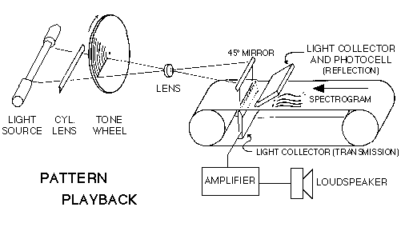
Cooper’s Pattern Playback

Slide 16
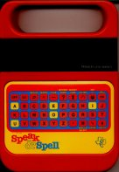
Pre-modern TTS systems
1960’s first full TTS: Umeda et al (1968)
1970’s
Joe Olive 1977 concatenation of linear-prediction diphones
Texas Instruments Speak and Spell,
June 1978
Paul Breedlove

Slide 17
Types of Synthesis
Articulatory Synthesis:
Model movements of articulators and acoustics of vocal tract
Formant Synthesis:
Start with acoustics, create rules/filters to create each formant
Concatenative Synthesis:
Use databases of stored speech to assemble new utterances.
Diphone
Unit Selection
Parametric (HMM) Synthesis
Trains parameters on databases of speech
Text modified from Richard Sproat slides

Slide 18
1980s: Formant Synthesis
Were the most common commercial systems when computers were slow and had little memory.
1979 MIT MITalk (Allen, Hunnicut, Klatt)
1983 DECtalk system based on Klatttalk
“Perfect Paul” (The voice of Stephen Hawking)
“Beautiful Betty”

Slide 19
1990s: 2nd Generation Synthesis Diphone Synthesis
Units are diphones; middle of one phone to middle of next.
Why? Middle of phone is steady state.
Record 1 speaker saying each diphone
~1400 recordings
Paste them together and modify prosody.

Slide 20
3rd Generation Synthesis Unit Selection Systems
Most current commercial systems.
Larger units of variable length
Record one speaker speaking 10 hours or more,
Have multiple copies of each unit
Use search to find best sequence of units

Slide 21
Parametric Synthesis
Very active area of research
Often associated with HMM Synthesis
Train a statistical model on large amounts of data.
Google showed that HMM-LSTM works well, fits better on device
Wavenet etc are the latest generation of parametric

Slide 22

In-class listening test
Enter your selections here: https://goo.gl/forms/KLLgwhnY04Y8fi9f2
Sample 1
Sample 2
Sample 3
Sample 4

Slide 23
TTS Demos: Diphone, Unit-Selection and Parametric
Festival
http://www.cstr.ed.ac.uk/projects/festival/morevoices.html
Google:
chrome-extension/::chhkejkkcghanjclmhhpncachhgejoel:ttsdemo.html
Cereproc
https://www.cereproc.com/en/products/voices

Slide 24
The two stages of TTS
PG&E will file schedules on April 20.
1. Text Analysis: Text into intermediate representation:
2. Waveform Synthesis: From the intermediate representation into waveform

Slide 25
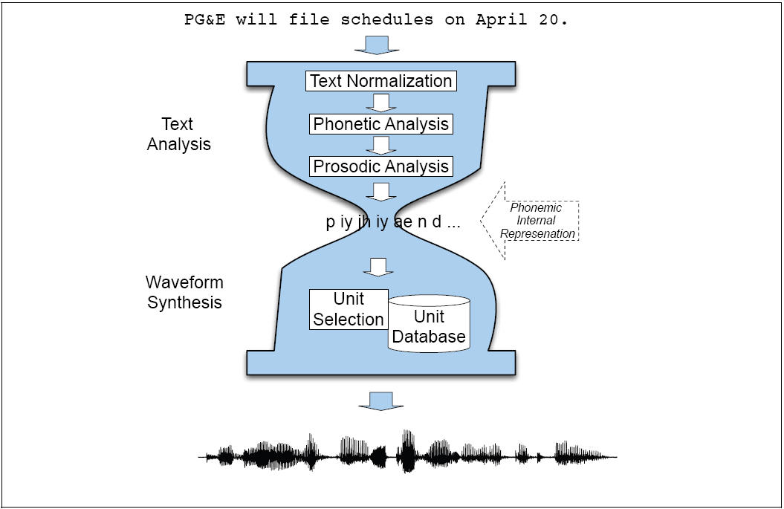

Slide 26
Outline
History of Speech Synthesis
State of the Art Demos
Brief Architectural Overview
Stage 1: Text Analysis
Text Normalization
Phonetic Analysis
Letter-to-sound (grapheme-to-phoneme)
Prosodic Analysis

Slide 27
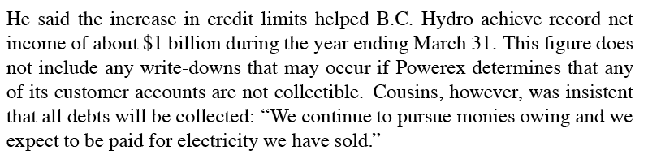
Text Normalization
Analysis of raw text into pronounceable words:
Sentence Tokenization
Text Normalization
Identify tokens in text
Chunk tokens into reasonably sized sections
Map tokens to words
Tag the words

Slide 28
Text Processing
He stole $100 million from the bank
It’s 13 St. Andrews St.
The home page is http://www.stanford.edu
Yes, see you the following tues, that’s 11/12/01
IV: four, fourth, I.V.
IRA: I.R.A. or Ira
1750: seventeen fifty (date, address) or one thousand seven… (dollars)

Slide 29
Text Normalization Steps
Identify tokens in text
Chunk tokens
Identify types of tokens
Convert tokens to words

Slide 30
Step 1: identify tokens and chunk
Whitespace can be viewed as separators
Punctuation can be separated from the raw tokens
For example, Festival converts text into
ordered list of tokens
each with features:
its own preceding whitespace
its own succeeding punctuation

Slide 31
Important issue in tokenization: end-of-utterance detection
Relatively simple if utterance ends in ?!
But what about ambiguity of “.”?
Ambiguous between end-of-utterance, end-of-abbreviation, and both
My place on Main St. is around the corner.
I live at 123 Main St.
(Not “I live at 151 Main St..”)

Slide 32
Rules/features for end-of-utterance detection
A dot with one or two letters is an abbrev
A dot with 3 cap letters is an abbrev.
An abbrev followed by 2 spaces and a capital letter is an end-of-utterance
Non-abbrevs followed by capitalized word are breaks

Slide 33
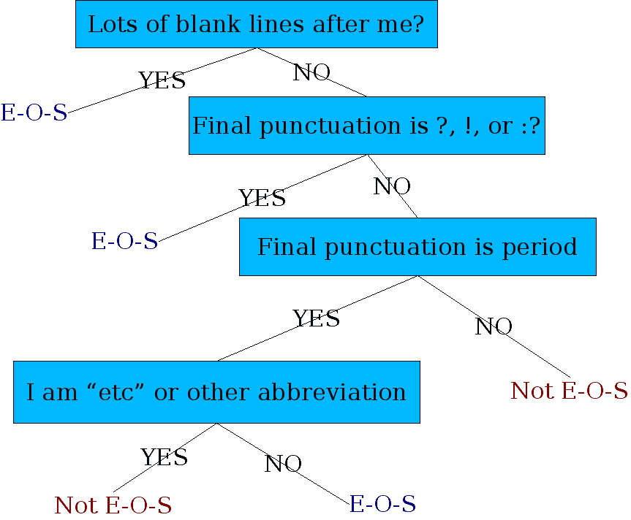
Simple Decision Tree

Slide 34
The Festival hand-built decision tree for end-of-utterance
((n.whitespace matches ".*\n.*\n[ \n]*") ;; A significant break in text
((1))
((punc in ("?" ":" "!"))
((1))
((punc is ".")
;; This is to distinguish abbreviations vs periods
;; These are heuristics
((name matches "\\(.*\\..*\\|[A-Z][A-Za-z]?[A-Za-z]?\\|etc\\)")
((n.whitespace is " ")
((0)) ;; if abbrev, single space enough for break
((n.name matches "[A-Z].*")
((1))
((0))))
((n.whitespace is " ") ;; if it doesn't look like an abbreviation
((n.name matches "[A-Z].*") ;; single sp. + non-cap is no break
((1))
((0)))
((1))))
((0)))))

Slide 35
Problems with the previous decision tree
Fails for
Cog. Sci. Newsletter
Lots of cases at end of line.
Badly spaced/capitalized sentences

Slide 36
More sophisticated decision tree features
Prob(word with “.” occurs at end-of-s)
Prob(word after “.” occurs at begin-of-s)
Length of word with “.”
Length of word after “.”
Case of word with “.”: Upper, Lower, Cap, Number
Case of word after “.”: Upper, Lower, Cap, Number
Punctuation after “.” (if any)
Abbreviation class of word with “.” (month name, unit-of-measure, title, address name, etc)
From Richard Sproat slides

Slide 37
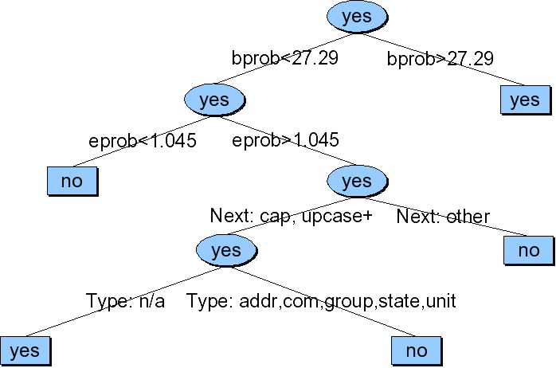
Sproat EOS tree
From Richard Sproat slides

Slide 38
Some good references on end-of-sentence detection
David Palmer and Marti Hearst. 1997. Adaptive Multilingual Sentence Boundary Disambiguation. Computational Linguistics 23, 2. 241-267.
David Palmer. 2000. Tokenisation and Sentence Segmentation. In “Handbook of Natural Language Processing”, edited by Dale, Moisl, Somers.

Slide 39
Steps 3+4: Identify Types of Tokens, and Convert Tokens to Words
Pronunciation of numbers often depends on type. Three ways to pronounce 1776:
Date: seventeen seventy six
Phone number: one seven seven six
Quantifier: one thousand seven hundred (and) seventy six
Also:
25 Day: twenty-fifth

Slide 40
Festival rule for dealing with “$1.2 million”
(define (token_to_words utt token name)
(cond
((and (string-matches name "\\$[0-9,]+\\(\\.[0-9]+\\)?")
(string-matches (utt.streamitem.feat utt token "n.name")
".*illion.?"))
(append
(builtin_english_token_to_words utt token (string-after name "$"))
(list
(utt.streamitem.feat utt token "n.name"))))
((and (string-matches (utt.streamitem.feat utt token "p.name")
"\\$[0-9,]+\\(\\.[0-9]+\\)?")
(string-matches name ".*illion.?"))
(list "dollars"))
(t
(builtin_english_token_to_words utt token name))))

Slide 41
Rules versus machine learning
Rules/patterns
Simple
Quick
Can be more robust
Easy to debug, inspect, and pass on
Vastly preferred in commercial systems
Machine Learning
Works for complex problems where rules hard to write
Higher accuracy in general
Worse generalization to very different test sets
Vastly preferred in academia

Slide 42
Machine learning for Text Normalization
Sproat, R., Black, A., Chen, S., Kumar, S., Ostendorf, M., and Richards, C. 2001. Normalization of Non-standard Words, Computer Speech and Language, 15(3):287-333
NSW examples:
Numbers:
123, 12 March 1994
Abbreviations, contractions, acronyms:
approx., mph. ctrl-C, US, pp, lb
Punctuation conventions:
3-4, +/-, and/or
Dates, times, urls, etc

Slide 43
How common are NSWs?
Word not in lexicon, or with non-alphabetic characters (Sproat et al 2001, before SMS/Twitter)
Text Type | % NSW
novels | 1.5%
press wire | 4.9%
e-mail | 10.7%
recipes | 13.7%
classified | 17.9%

Slide 44
How common are NSWs?
Word not in gnu aspell dictionary (Han, Cook, Baldwin 2013) not counting @mentions, #hashtags, urls,
Twitter: 15% of tweets have 50% or more OOV

Slide 45
Twitter variants
Han, Cook, Baldwin 2013
Category | Example | %
Letter changed (deleted) | shuld | 72%
Slang | lol | 12%
Other | sucha | 10%
Number Substitution | 4 (“for”) | 3%
Letter and Number | b4 (“before”) | 2%

Slide 46
State of the Art for Twitter normalization
Simple one-to-one normalization (map OOV to a single IV word)
Han, Cook, and Baldwin 2013
Create a typed-based dictionary of mappings
tmrw -> tomorrow
Learned over a large corpus by combining distributional similarity and string similarity

Slide 47
4 steps to Sproat et al. algorithm
Splitter (on whitespace or also within word (“AltaVista”)
Type identifier: for each split token identify type
Token expander: for each typed token, expand to words
Deterministic for number, date, money, letter sequence
Only hard (nondeterministic) for abbreviations
Language Model: to select between alternative pronunciations
From Alan Black slides

Slide 48
Step 1: Splitter
Letter/number conjunctions (WinNT, SunOS, PC110)
Hand-written rules in two parts:
Part I: group things not to be split (numbers, etc; including commas in numbers, slashes in dates)
Part II: apply rules:
At transitions from lower to upper case
After penultimate upper-case char in transitions from upper to lower
At transitions from digits to alpha
At punctuation
From Alan Black Slides

Slide 49
Step 2: Classify token into 1 of 20 types
EXPN: abbrev, contractions (adv, N.Y., mph, gov’t)
LSEQ: letter sequence (CIA, D.C., CDs)
ASWD: read as word, e.g. CAT, proper names
MSPL: misspelling
NUM: number (cardinal) (12,45,1/2, 0.6)
NORD: number (ordinal) e.g. May 7, 3rd, Bill Gates II
NTEL: telephone (or part) e.g. 212-555-4523
NDIG: number as digits e.g. Room 101
NIDE: identifier, e.g. 747, 386, I5, PC110
NADDR: number as stresst address, e.g. 5000 Pennsylvania
NZIP, NTIME, NDATE, NYER, MONEY, BMONY, PRCT,URL, etc
SLNT: not spoken (KENT*REALTY)

Slide 50
More about the types
4 categories for alphabetic sequences:
EXPN: expand to full word(s) (fplc= fireplace, NY=New York)
LSEQ: say as letter sequence (IBM)
ASWD: say as standard word (either OOV or acronyms)
5 main ways to read numbers:
Cardinal (quantities)
Ordinal (dates)
String of digits (phone numbers)
Pair of digits (years)
Trailing unit: serial until last non-zero digit: 8765000 is “eight seven six five thousand” (phone #s, long addresses)
But still exceptions: (947-3030, 830-7056)

Slide 51
Type identification classifier
Hand label a large training set, build classifier
Example features for alphabetic tokens:
P(o|t) for t in ASWD, LSWQ, EXPN (from trigram letter model)
P(t) from counts of each tag in text
P(o) normalization factor
P(t|o) = p(o|t)p(t)/p(o)

Slide 52
Type identification algorithm
Hand-written context-dependent rules:
List of lexical items (Act, Advantage, amendment) after which Roman numbers are read as cardinals not ordinals
Classifier accuracy:
98.1% in news data,
91.8% in email

Slide 53
Step 3: expand NSW Tokens by type-specific rules
ASWD expands to itself
LSEQ expands to list of words, one for each letter
NUM expands to string of words representing cardinal
NYER expand to 2 pairs of NUM digits…
NTEL: string of digits with silence for puncutation

Slide 54
In practice
NSWs are still mainly done by rule in TTS systems
Moving towards ML approaches
Labeled data not readily available for the task

Slide 55
Homograph disambiguation

Slide 56
Homograph disambiguation
19 most frequent homographs, from Liberman and Church 1992
Counts are per million, from an AP news corpus of 44 million words.
Not a huge problem, but still important
use 319
increase 230
close 215
record 195
house 150
contract 143
lead 131
live 130
lives 105
protest 94
survey 91
project 90
separate 87
present 80
read 72
subject 68
rebel 48
finance 46
estimate 46

Slide 57
POS Tagging for homograph disambiguation
Many homographs can be distinguished by POS
use y uw s y uw z
close k l ow s k l ow z
house h aw s h aw z
live l ay v l ih v
REcord reCORD
INsult inSULT
OBject obJECT
OVERflow overFLOW
DIScount disCOUNT
CONtent conTENT
POS tagging also useful for CONTENT/FUNCTION distinction, which is useful for phrasing

Slide 58
Festival
Open source speech synthesis system
Designed for development and runtime use
Use in many commercial and academic systems
Hundreds of thousands of users
Multilingual
No built-in language
Designed to allow addition of new languages
Additional tools for rapid voice development
Statistical learning tools
Scripts for building models
Text from Richard Sproat

Slide 59
Festival as software
http://festvox.org/festival/
General system for multi-lingual TTS
C/C++ code with Scheme scripting language
General replaceable modules:
Lexicons, LTS, duration, intonation, phrasing, POS tagging, tokenizing, diphone/unit selection, signal processing
General tools
Intonation analysis (f0, Tilt), signal processing, CART building, N-gram, SCFG, WFST
Text from Richard Sproat

Slide 60
CMU FestVox project
Festival is an engine, how do you make voices?
Festvox: building synthetic voices:
Tools, scripts, documentation
Discussion and examples for building voices
Example voice databases
Step by step walkthroughs of processes
Support for English and other languages
Support for different waveform synthesis methods
Diphone
Unit selection
Text from Richard Sproat

Slide 61
Synthesis tools
I want my computer to talk
Festival Speech Synthesis
I want my computer to talk in my voice
FestVox Project
I want it to be fast and efficient
Flite
Text from Richard Sproat

Slide 62
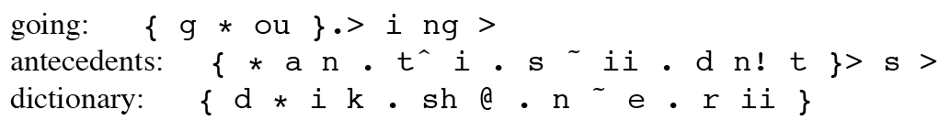
Dictionaries
CMU dictionary: 127K words
http://www.speech.cs.cmu.edu/cgi-bin/cmudict
Unisyn dictionary
Significantly more accurate, includes multiple dialects
http://www.cstr.ed.ac.uk/projects/unisyn/

Slide 63
Dictionaries aren’t always sufficient: Unknown words
Go up with square root of # of words in text
Mostly person, company, product names
From a Black et al analysis
5% of tokens in a sample of WSJ not in the OALD dictionary
77%: Names
20% Other Unknown Words
4%: Typos
So commercial systems have 3-part system:
Big dictionary
Special code for handling names
Machine learned LTS system for other unknown words

Slide 64
Names
Big problem area is names
Names are common
20% of tokens in typical newswire text
Spiegel (2003) estimate of US names:
2 million surnames
100,000 first names
Personal names: McArthur, D’Angelo, Jiminez, Rajan, Raghavan, Sondhi, Xu, Hsu, Zhang, Chang, Nguyen
Company/Brand names: Infinit, Kmart, Cytyc, Medamicus, Inforte, Aaon, Idexx Labs, Bebe

Slide 65
Methods for Names
Can do morphology (Walters -> Walter, Lucasville)
Can write stress-shifting rules (Jordan -> Jordanian)
Rhyme analogy: Plotsky by analogy with Trostsky (replace tr with pl)
Liberman and Church: for 250K most common names, got 212K (85%) from these modified-dictionary methods, used LTS for rest.
Can do automatic country detection (from letter trigrams) and then do country-specific rules

Slide 66
Letter to Sound Rules
AKA Grapheme to Phoneme (G2P)
Generally machine learning, induced from a dictionary
Pick your favorite machine learning tool and go for it
Earlier work: (Black et al. 1998)
Two steps: alignment and (CART-based) rule-induction

Slide 67
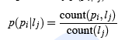
Alignment
Letters: c h e c k e d
Phones: ch _ eh _ k _ t
Black et al Method 1 (EM)
First scatter epsilons in all possible ways to cause letters and phones to align
Then collect stats for P(phone|letter) and select best to generate new stats
Iterate 5-6 times until settles

Slide 68
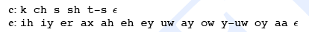
Alignment
Black et al method 2
Hand specify which letters can be rendered as which phones
C goes to k/ch/s/sh
W goes to w/v/f, etc
An actual list:
Once mapping table is created, find all valid alignments, find p(letter|phone), score all alignments, take best

Slide 69
Alignment
Some alignments will turn out to be really bad.
These are just the cases where pronunciation doesn’t match letters:
Dept d ih p aa r t m ah n t
CMU s iy eh m y uw
Lieutenant l eh f t eh n ax n t (British)
Or foreign words
These can just be removed from alignment training
Also remove and deal separately with names and acronyms

Slide 70
Black et al. Classifier
A CART tree for each letter in alphabet (26 plus accented) using context of +-3 letters
# # # c h e c -> ch
c h e c k e d -> _
This produces 92-96% correct LETTER accuracy (58-75 word acc) for English

Slide 71
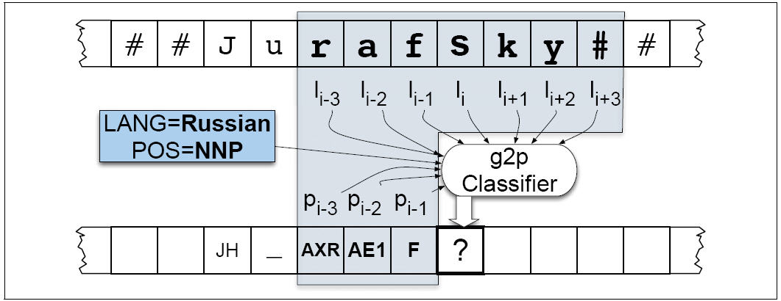
Modern systems: more powerful classifiers, more features

Slide 72
Predicting Intonation in TTS
Prominence/Accent: Decide which words are accented, which syllable has accent, what sort of accent
Boundaries: Decide where intonational boundaries are
Duration: Specify length of each segment
F0: Generate F0 contour from these

Slide 73
Predicting Intonation in TTS
Prominence/Accent: Decide which words are accented, which syllable has accent, what sort of accent
Boundaries: Decide where intonational boundaries are
Duration: Specify length of each segment
F0: Generate F0 contour from these

Slide 74
Stress vs. accent
Stress: structural property of a word
Fixed in the lexicon: marks a potential (arbitrary) location for an accent to occur, if there is one
Accent: property of a word in context
Context-dependent. Marks important words in the discourse
(x) |  |  |  |  |  | (x) |  |  | (accented syll)
x |  |  |  |  |  | x |  |  | stressed syll
x |  |  |  | x |  | x |  |  | full vowels
x | x | x |  | x | x | x | x |  | syllables
vi | ta | mins |  | Ca | li | for | nia

Slide 75
Stress vs. accent (2)
The speaker decides to make the word vitamin more prominent by accenting it.
Lexical stress tell us that this prominence will appear on the first syllable, hence vitamin.
So we will have to look at both the lexicon and the context to predict the details of prominence
I’m a little surprised to hear it characterized as upbeat

Slide 76
Levels of prominence
Most phrases have more than one accent
Nuclear Accent: Last accent in a phrase, perceived as more prominent
Plays semantic role like indicating a word is contrastive or focus.
Modeled via ***s in IM, or capitalized letters
‘I know SOMETHING interesting is sure to happen,’ she said
Can also have reduced words that are less prominent than usual (especially function words)
Sometimes use 4 classes of prominence:
Emphatic accent, pitch accent, unaccented, reduced

Slide 77
Pitch accent prediction
Which words in an utterance should bear accent?
i believe at ibm they make you wear a blue suit.
i BELIEVE at IBM they MAKE you WEAR a BLUE SUIT.
2001 was a good movie, if you had read the book.
2001 was a good MOVIE, if you had read the BOOK.

Slide 78
Broadcast News Example
Hirschberg (1993)
SUN MICROSYSTEMS INC, the UPSTART COMPANY that HELPED LAUNCH the DESKTOP COMPUTER industry TREND TOWARD HIGH powered WORKSTATIONS, was UNVEILING an ENTIRE OVERHAUL of its PRODUCT LINE TODAY. SOME of the new MACHINES, PRICED from FIVE THOUSAND NINE hundred NINETY five DOLLARS to seventy THREE thousand nine HUNDRED dollars, BOAST SOPHISTICATED new graphics and DIGITAL SOUND TECHNOLOGIES, HIGHER SPEEDS AND a CIRCUIT board that allows FULL motion VIDEO on a COMPUTER SCREEN.

Slide 79
Predicting Pitch Accent: Part of speech
Content words are usually accented
Function words are rarely accented
Of, for, in on, that, the, a, an, no, to, and but or will may would can her is their its our there is am are was were, etc
Baseline algorithm: Accent all content words.

Slide 80
Factors in accent prediction: Contrast
Legumes are poor source of VITAMINS
No, legumes are a GOOD source of vitamins
I think JOHN or MARY should go
No, I think JOHN AND MARY should go

Slide 81
Factors in Accent Prediction: List intonation
I went and saw ANNA, LENNY, MARY, and NORA.

Slide 82
Factors: Word order
Preposed items are accented more frequently
TODAY we will BEGIN to LOOK at FROG anatomy.
We will BEGIN to LOOK at FROG anatomy today.

Slide 83

Factor: Information
New information in an answer is often accented
Q1: What types of foods are a good source of vitamins?
A1: LEGUMES are a good source of vitamins.
Q2: Are legumes a source of vitamins?
A2: Legumes are a GOOD source of vitamins.
Q3: I’ve heard that legumes are healthy, but what are they a good source of ?
A3: Legumes are a good source of VITAMINS.
Slide from Jennifer Venditti

Slide 84
Factors: Information Status (2)
New versus old information.
Old information is deaccented
There are LAWYERS, and there are GOOD lawyers
EACH NATION DEFINES its OWN national INTERST.
I LIKE GOLDEN RETRIEVERS, but MOST dogs LEAVE me COLD.

Slide 85
Complex Noun Phrase Structure
Sproat, R. 1994. English noun-phrase accent prediction for text-to-speech. Computer Speech and Language 8:79-94.
Proper Names, stress on right-most word
New York CITY; Paris, FRANCE
Adjective-Noun combinations, stress on noun
Large HOUSE, red PEN, new NOTEBOOK
Noun-Noun compounds: stress left noun
HOTdog (food) versus adj-N HOT DOG (overheated animal)
WHITE house (place) versus adj-N WHITE HOUSE (painted)
Other:
MEDICAL Building, APPLE cake, cherry PIE, kitchen TABLE
Madison avenue, Park street?
Rule: Furniture+Room -> RIGHT

Slide 86
Other features
POS
POS of previous word
POS of next word
Stress of current, previous, next syllable
Unigram probability of word
Bigram probability of word
Position of word in sentence

Slide 87
Advanced features
Accent is often deflected away from a word due to focus on a neighboring word.
Could use syntactic parallelism to detect this kind of contrastive focus:
……driving [FIFTY miles] an hour in a [THIRTY mile] zone
[WELD] [APPLAUDS] mandatory recycling. [SILBER] [DISMISSES] recycling goals as meaningless.
…but while Weld may be [LONG] on people skills, he may be [SHORT] on money

Slide 88
Accent prediction
Useful features include: (starting with Hirschberg 1993)
Lexical class (function words, clitics not accented)
Word frequency
Word identity (promising but problematic)
Given/New, Theme/Rheme
Focus
Word bigram predictability
Position in phrase
Complex nominal rules (Sproat)
Combined in a classifier:
Decision trees (Hirchberg 1993), Bagging/boosting (Sun 2002)
Hidden Markov models (Hasegawa-Johnson et al 2005)
Conditional random fields (Gregory and Altun 2004)

Slide 89
But best single feature: Accent ratio dictionary
Nenkova, J. Brenier, A. Kothari, S. Calhoun, L. Whitton, D. Beaver, and D. Jurafsky. 2007. To memorize or to predict: Prominence labeling in conversational speech. in Proceedings of NAACL-HLT
Of all the times this word occurred
What percentage were accented?
Memorized from a labeled corpus
60 Switchboard conversations (Ostendorf et al 2001)
Given:
k: number of times a word is prominent
n: all occurrences of the word

Slide 90
Accent Ratio
Conversational speech dictionaries:
http://www.cis.upenn.edu/~nenkova/AR.sign
Read News dictionaries:
http://www.cis.upenn.edu/~nenkova/buAR.sign
Accent ratio classifier
a word not-prominent if AR < 0.38
words not in the AR dictionary are labeled “prominent”
Performance
Best single predictor of accent; adding all other features only helps 1% on prediction task
Improves TTS:
Volker Strom, Ani Nenkova, Robert Clark, Yolanda Vazquez-Alvarez, Jason Brenier, Simon King, and Dan Jurafsky. 2007. Modelling Prominence and Emphasis Improves Unit-Selection Synthesis. Interspeech

Slide 91
Predicting Intonation in TTS
Prominence/Accent: Decide which words are accented, which syllable has accent, what sort of accent
Boundaries: Decide where intonational boundaries are
Duration: Specify length of each segment
F0: Generate F0 contour from these

Slide 92
Predicting Boundaries: Full || versus intermediate |
Ostendorf and Veilleux. 1994 “Hierarchical Stochastic model for Automatic Prediction of Prosodic Boundary Location”, Computational Linguistics 20:1
Computer phone calls, || which do everything | from selling magazine subscriptions || to reminding people about meetings || have become the telephone equivalent | of junk mail. ||
Doctor Norman Rosenblatt, || dean of the college | of criminal justice at Northeastern University, || agrees.||
For WBUR, || I’m Margo Melnicove.

Slide 93
Simplest CART
(set! simple_phrase_cart_tree
'
((lisp_token_end_punc in ("?" "." ":"))
((BB))
((lisp_token_end_punc in ("'" "\"" "," ";"))
((B))
((n.name is 0) ;; end of utterance
((BB))
((NB))))))

Slide 94
More complex features
Ostendorf and Veilleux
English: boundaries are more likely between content words and function words
Syntactic structure (parse trees)
Largest syntactic category dominating preceding word but not succeeding word
How many syntactic units begin/end between words
Type of function word to right
Capitalized names
# of content words since previous function word

Slide 95
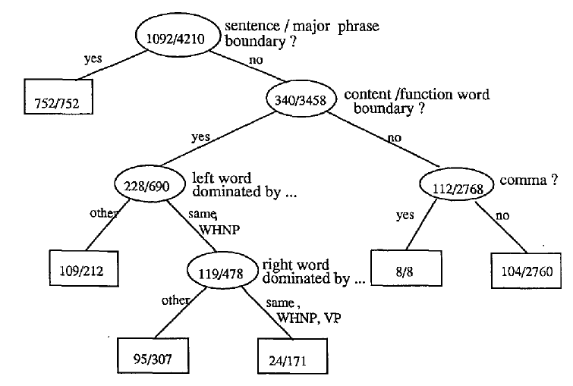
Ostendorf and Veilleux CART

Slide 96
Predicting Intonation in TTS
Prominence/Accent: Decide which words are accented, which syllable has accent, what sort of accent
Boundaries: Decide where intonational boundaries are
Duration: Specify length of each segment
F0: Generate F0 contour from these

Slide 97
Duration
Simplest: fixed size for all phones (100 ms)
Next simplest: average duration for that phone (from training data). Samples from SWBD in ms:
aa 118 b 68
ax 59 d 68
ay 138 dh 44
eh 87 f 90
ih 77 g 66
Next Next Simplest: add in phrase-final and initial lengthening plus stress

Slide 98
Klatt duration rules
Models how context-neutral duration of a phone lengthened/shortened by context, while staying above a min duration dmin
Prepausal lengthening: vowel before pause lengthened by 1.4
Non-phrase-final shortening: Segments not phrase-final are shortened by 0.6. Phrase-final postvocalic liquids and nasals lengthened by 1.4
Unstressed shortening: unstressed segments minimum duration dmin is halved, and are shortened by .7 for most phone types.
Lengthening for accent: A vowel with accent lengthened by 1.4
Shortening in clusters: Consonant followed by consonant shortened by 0.5
Pre-voiceless shortening: Vowels are shortened before a voiceless plosive by 0.7

Slide 99
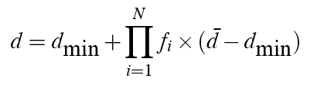
Klatt duration rules
Klatt formula for phone durations:
Festival: 2 options
Klatt rules
Use labeled training set with Klatt features to train CART
Identity of the left and right context phone
Lexical stress and accent values of current phone
Position in syllable, word, phrase
Following pause

Slide 100
Duration: state of the art
Lots of fancy models of duration prediction:
Using Z-scores and other clever normalizations
Sum-of-products model
New features like word predictability
Words with higher bigram probability are shorter

Slide 101
Outline
History, Demos
Architectural Overview
Stage 1: Text Analysis
Text Normalization
Tokenization
End of sentence detection
Homograph disambiguation
Letter-to-sound (grapheme-to-phoneme)
Prosody
Predicting Accents
Predicting Boundaries
Predicting Duration
Generating F0

